Slide 1
Report for Community Council
21st Feb – 18th March 2022

Slide 2
Numbers:
We have worked with 190 young people
This equated to 210 learning hours
This happened at 26 different activities

Slide 3
International Last Aid with Highland Hospice.
16 people in Cromarty are now Last Aiders
Every one was presented with Certificates
The courses covered:
- Good Life
- Good Death
- Good Grief

Slide 4
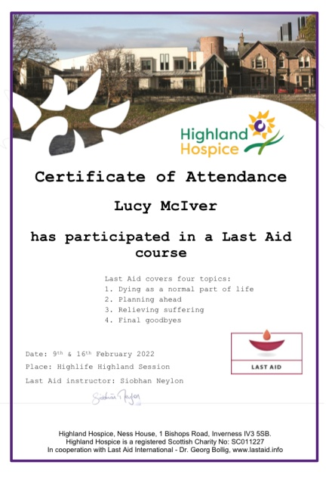
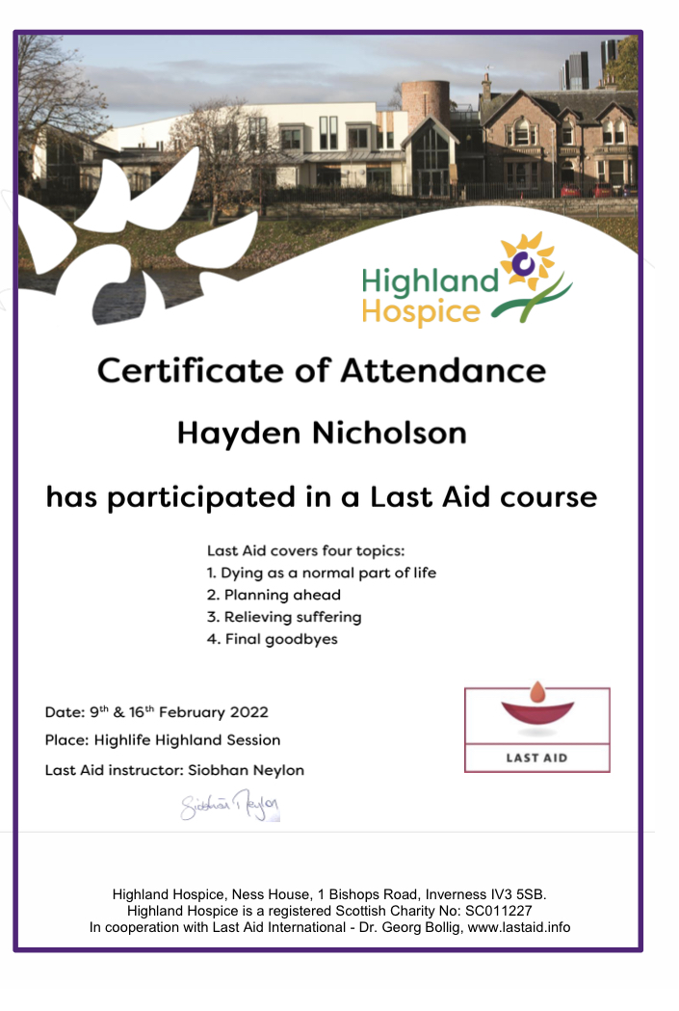
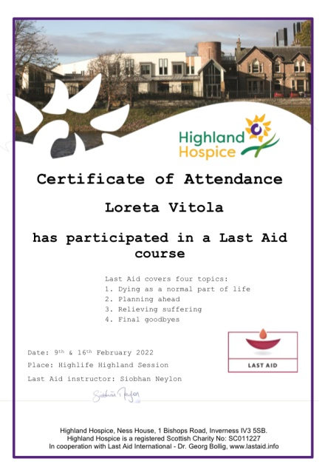
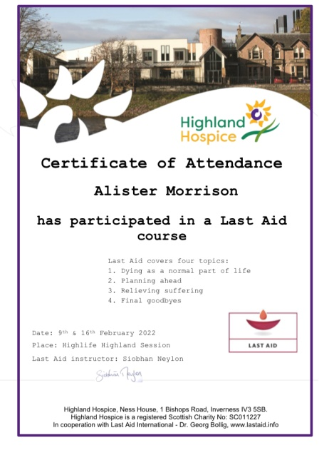
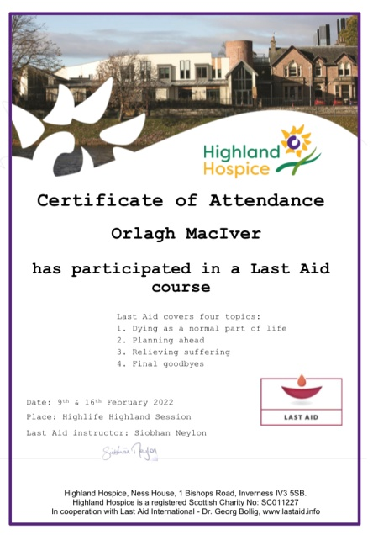

Slide 5
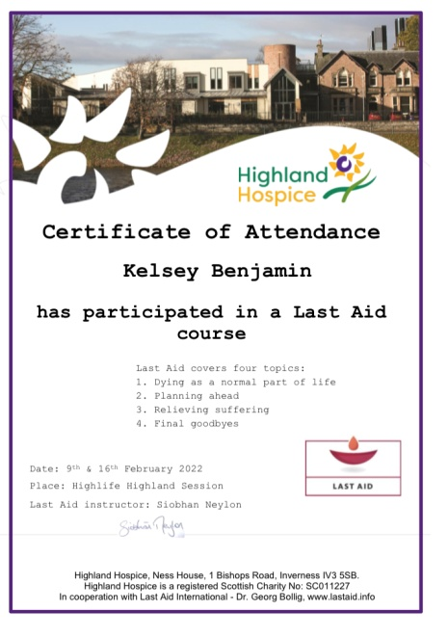
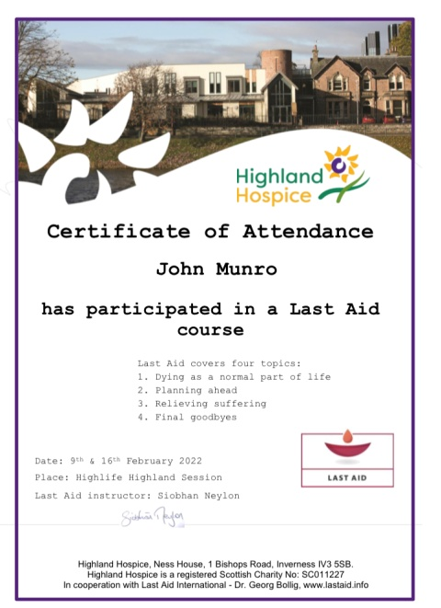
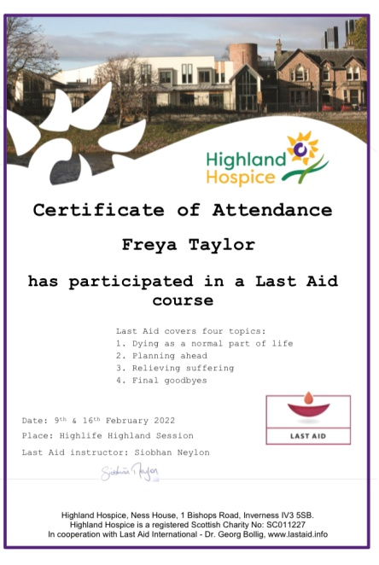
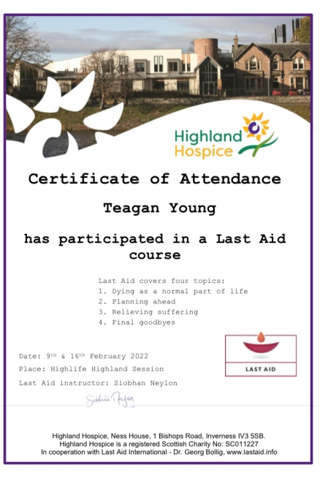
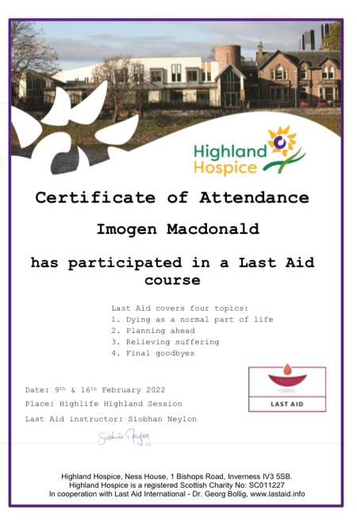
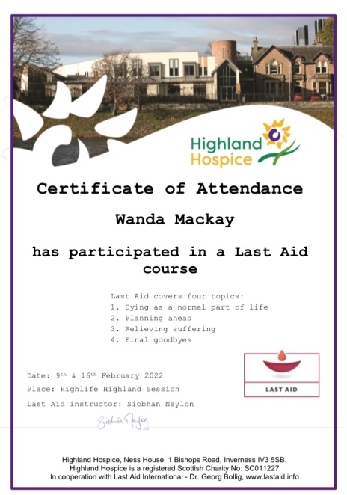

Slide 6
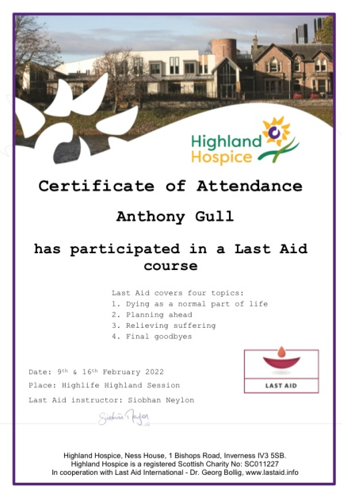
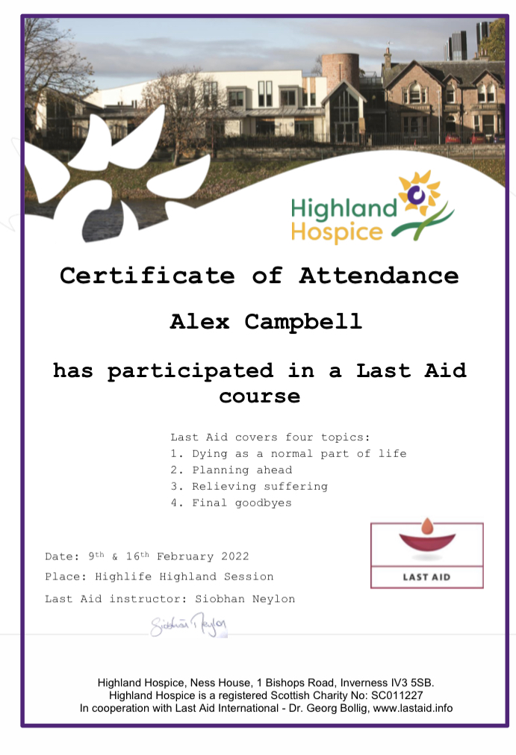
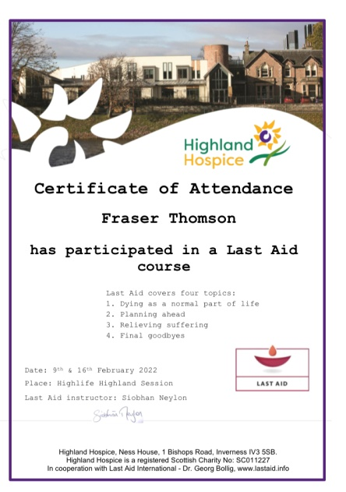
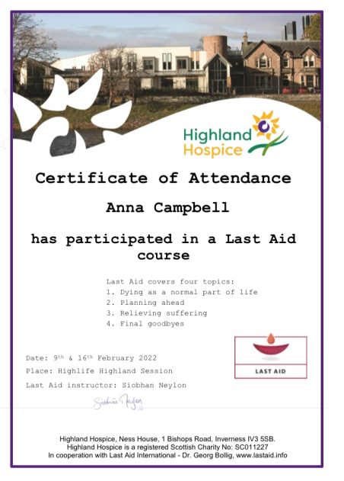
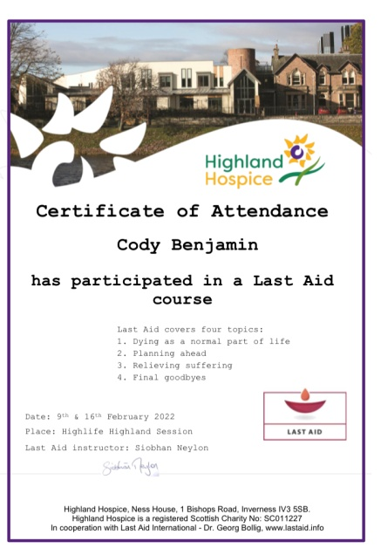

Slide 7
Cromarty Youth Cafes Intergenerational Journey
Wanda and myself were invited along to host a workshop and deliver a presentation at the Generations Working together GWT International Intergenerational week showcasing all the Intergenerational work over that last 12 years.
We planned a 45 min presentation and hosted a Q and A session with stakeholders and projects from across the world in attendance .
Wanda attended and supported daily sessions

Slide 8
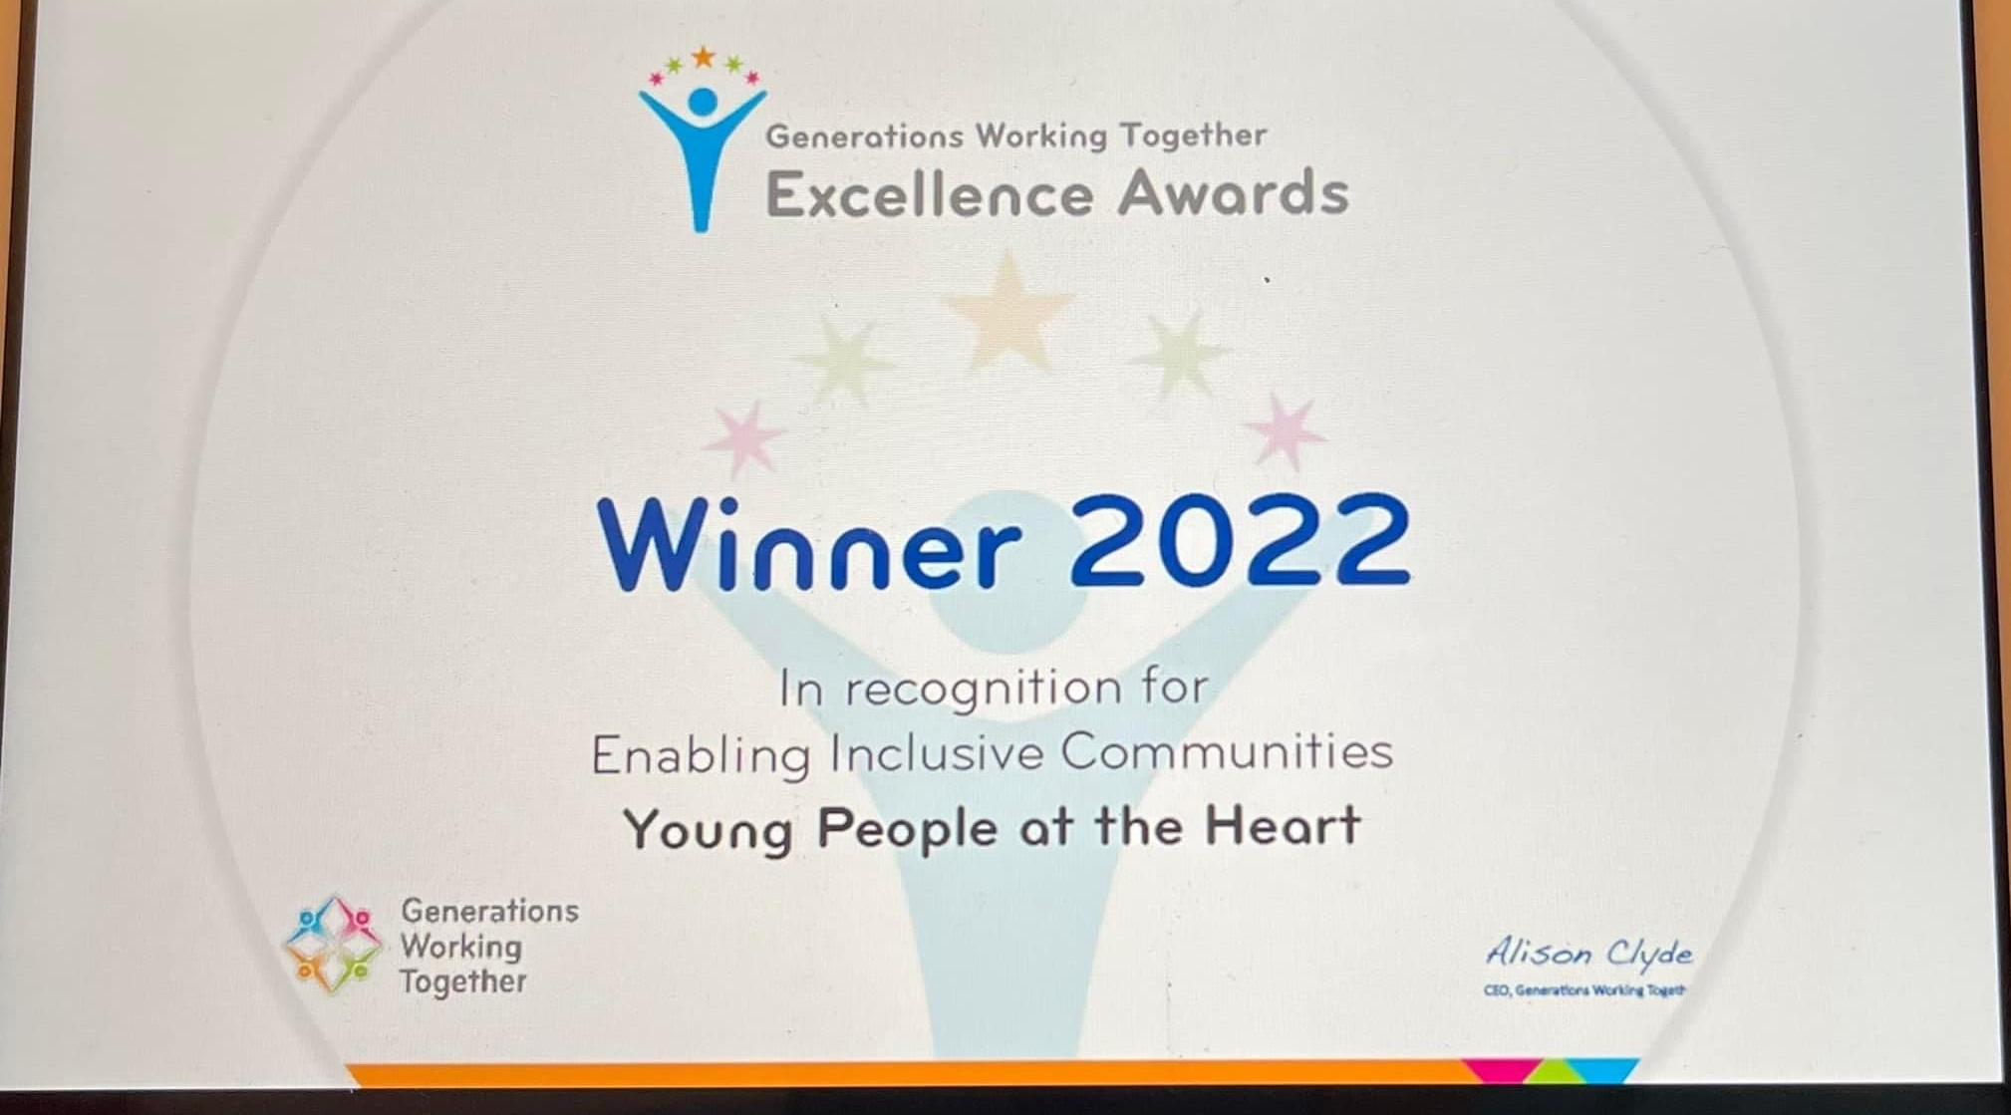
Intergenerational Work.
Black Isle Youth Work recently won one of Generations Working Together’s Excellence Awards - the 'Young people at the heart of intergenerational work' project for winning under the Enabling Inclusive Communities category.
CEO of GWT Allison Clyde wrote: “Well done Wanda and your fantastic band of volunteers and staff. Well deserved indeed.”
Below is a link to the video that was created for us winning the award.
https://m.youtube.com/watch?v=DvTjX767Lu0&feature=share

Slide 9
Testing for Change
This project is from Funding from the Scottish Government and is issued from the Highland Council,
There is two groups of young people
The applicants and the Decision makers:
The applicants did a consultation of what activities young people would like to see happen for an easter programme,
Then they needed to present their ideas to the Decision makers -

Slide 10
Testing for Change
Our decision makers were picked from various participation form:
Ethan Paterson – Equalities & Diversity Group
Tilly Grist – CCRC, HYP, Northern Alliance & CDCC Cllr
Teagan Young – CCRC Rep, Cromarty Youth Café, CDCC Youth Rep
Anthony Gull – Cromarty Youth Café Rep
Hayden Nicholson – Cromarty Youth Café Rep
What the group would like funded:
Creativity in Care Workshop
Buddy Bench
Trip to Inverness Go Kart Track
Trip to Roller Bowl
Football Coaching
Trip to Inverness Trampoline Park

Slide 11
Outcomes Learned by the Decision Makers and young people taking part in consultations:
Young people had many conversations by listening to the points of views from other young people
One YP suggested that sitting in a circle would be the best option for discussion as they have experience of taking part in many participations forum and this is the best way for healthy discussions.
Young people sat in a circle this was good as they were able to make eye contact and showing they are activity listening. Everyone was given the options to speak and give their opinion.
The setting was informal where YP had the option to help themselves to refreshments.
How to negotiate and have healthy debates by listening to everyone in the group
How to reach a fair agreement by listening to everyone in the group
How to reach a decision through discussion.
The voting process:
After listening to all the project ideas
YP decided to use a voting process with either YES or NO for each project.
This was done anonymously on Post It Notes, the post its were placed in a bowl, then one young person gathered them together and gave the tally of votes – all the votes were YES there was no NO’s

Slide 12
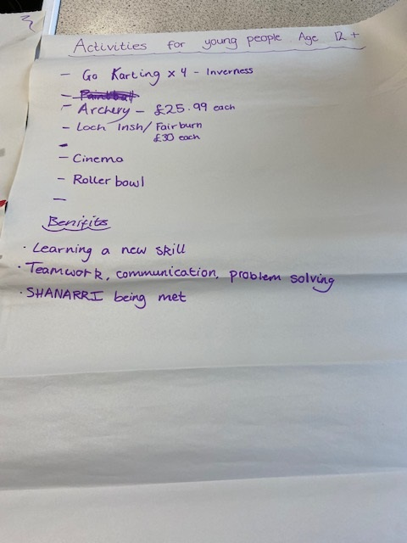
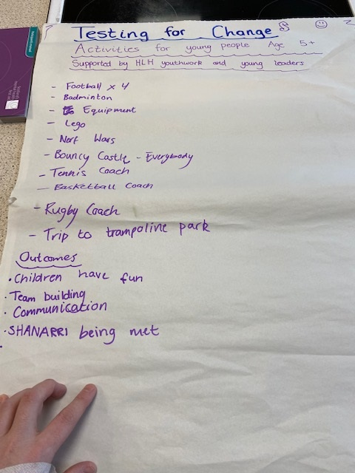
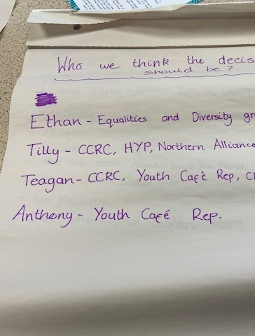
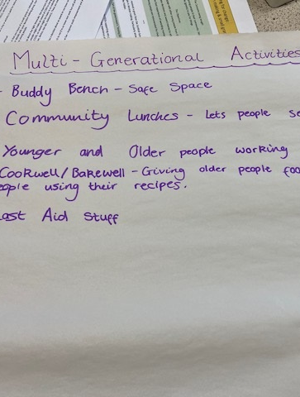
Evidence from the consultation

Slide 13
Partnership Working
Waverley Care Wave length Programme – working with 130 young people aged 15+ from across the ASG. The programme looks at sexual health, teen pregnancy's, STI’s
Meeting with Skills development Scotland (SDS) – looking at supporting John Munro with his personal development in taking part in an SVQ in Youth Work .
CFINE attached project report
Highlife Highland Active Schools
Activity Providers

Slide 14
1-1’s
Emotional Checks in
Cookwell / Bakewell
Building confidence
Supporting YP to take part in driving theory test
Supporting YP to take part in school subjects
Listening to young peoples fears about leaving school and transitioning in the world of work, a number of young people are feeling anxious about leaving school as school in there safe zone and now they are stepping out of it.

Slide 15
100th Birthday Card
Wanda asked Orlagh & Loreta created a birthday card for a lady in Shoremills care home.
This was done on the back of the Age Scotland Devices that went to Shoremills to enable older people to become digitally connected.
As it was her 100th Birthday we got over 100 signatures for the card.

Slide 16
Funding Applications
Funding done to Black Isle Need to Play for sessions of young person disengaging at Glachbeg Croft - Successful
Testing for Change Application – this was successful. The YP were granted the £1500 for their activities
Loneliness & Isolation Fund application submitted for intergenerational activities & sessions

Slide 17
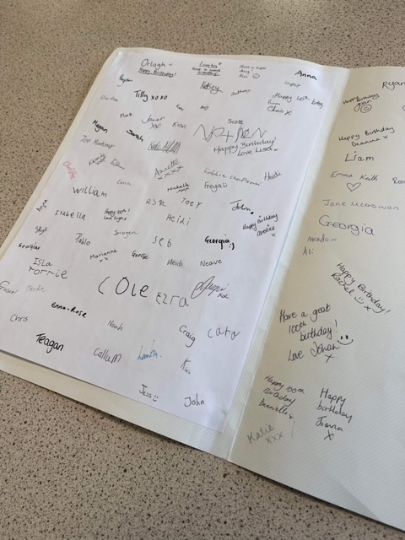
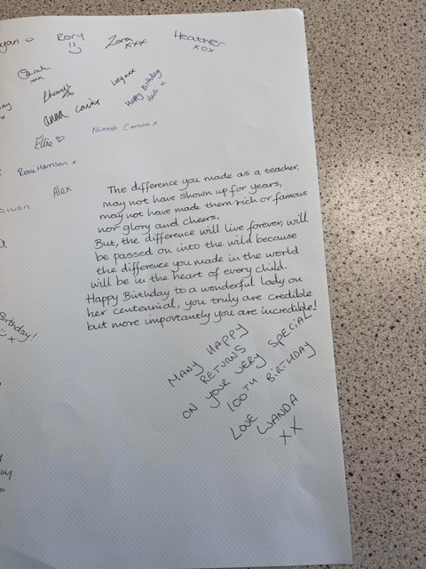
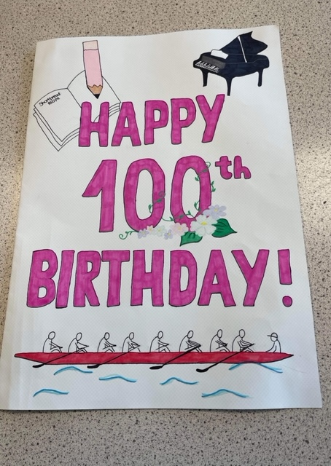

Slide 18
Inservice Day Provision
Young leaders had a trip to Vue Cinema to Watch Uncharted – this film was picked by the young people
Football Coaching with ICT

Slide 19
Multi Sports
Every Monday night, this is led by Young leaders
The young leaders are working toward Their Choose Lead Level 4 with High Life Highland
Young leaders plan , deliver and then review the session
The plan is always delivered around what young people want,
Each week young people are playing new games and are working on different skills, such as team work, throwing and catching, & communication skills

Slide 20
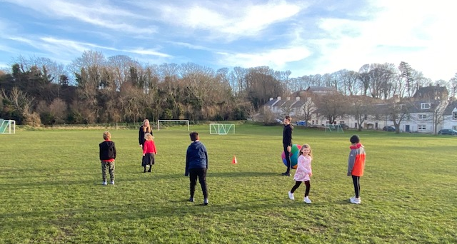
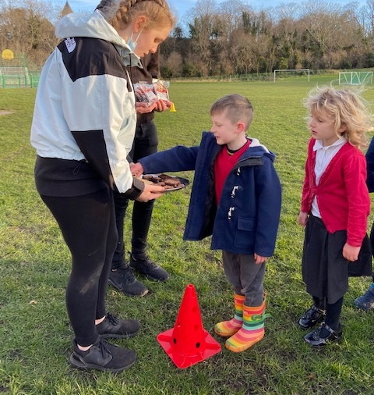
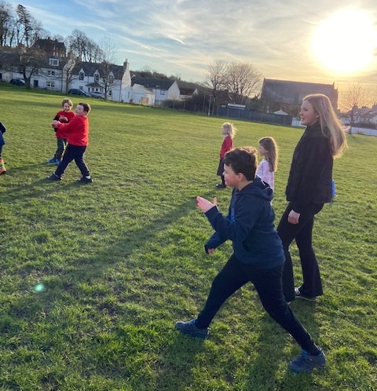
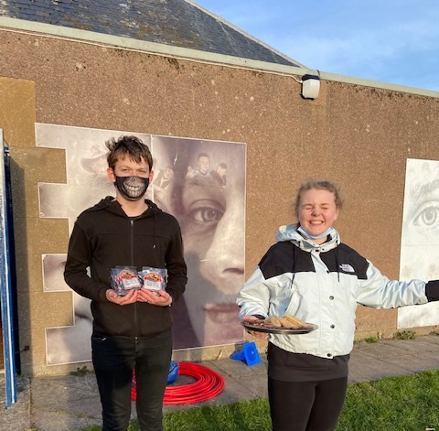

Slide 21
Football Coaching with ICT
Football coaching with coaches from Inverness Caley Thistle
Young people were looking at creating their own football team, they were asked to create their own Logo, thinking about colours for the strip and who would be on the team.
The following week young people asked to think about writing the front page for a newspaper. Thinking about the story what type of picture should go in, what adverts should be on the paper and what the paper is called
Young people are gaining new skills each week. I know this as I am seeing an improvement and the coaches have told me.

Slide 22
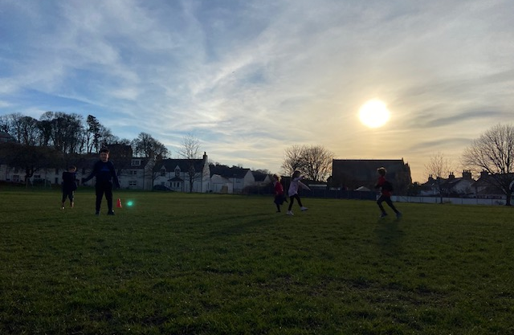
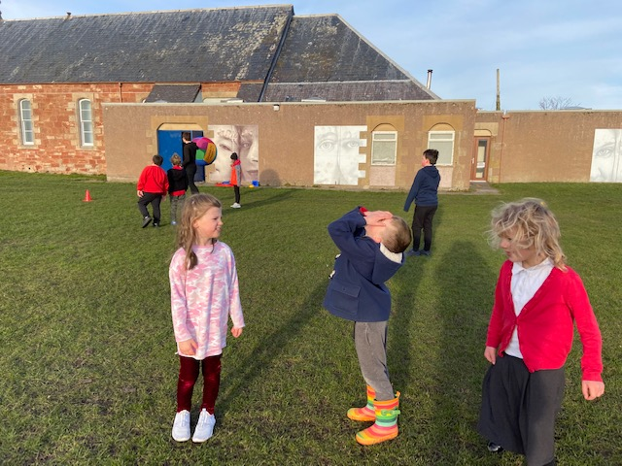
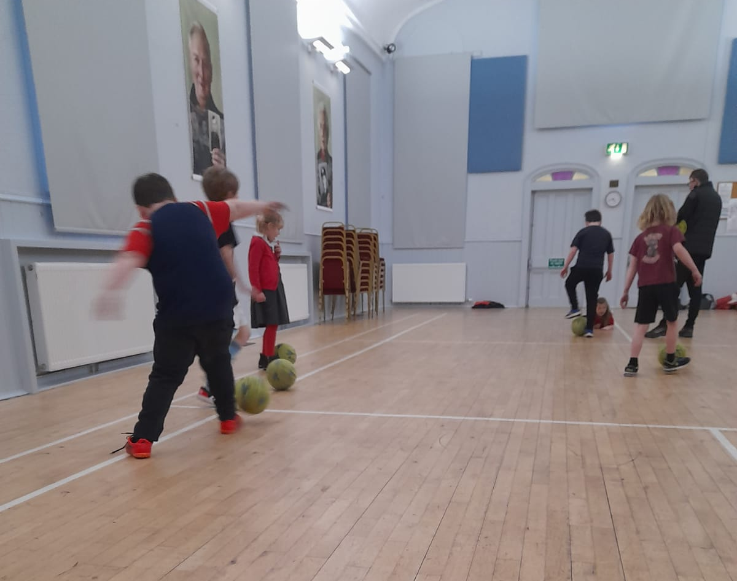
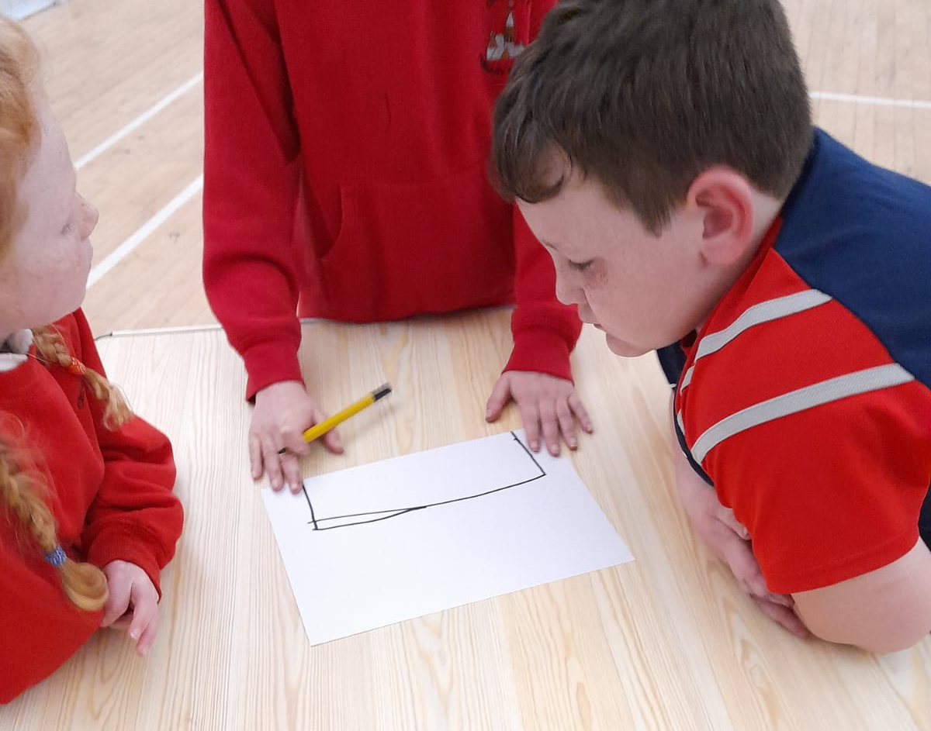

Slide 23
Jnr Youth Cafe
One week the young people were working on problem solving, they were given a packet of spaghetti & tape and asked to create a spaghetti bridge. That was strong enough to hold a phone. There was lots a good team work and communication happening with the young people.
Our activities are done in consultation with young people
At every Jnr Youth Café Session young people are fed with a range of hot cooked meals and range of snacks.
All the young people really enjoy taking part in the youth café

Slide 24
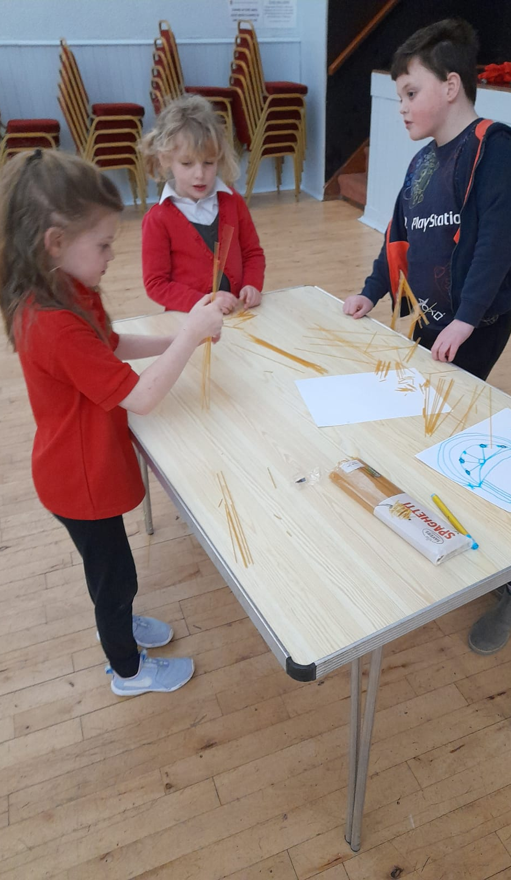
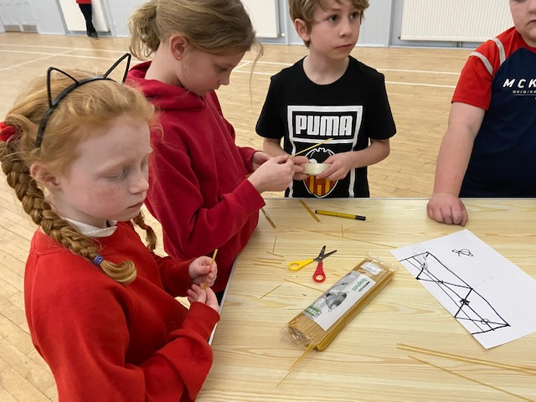
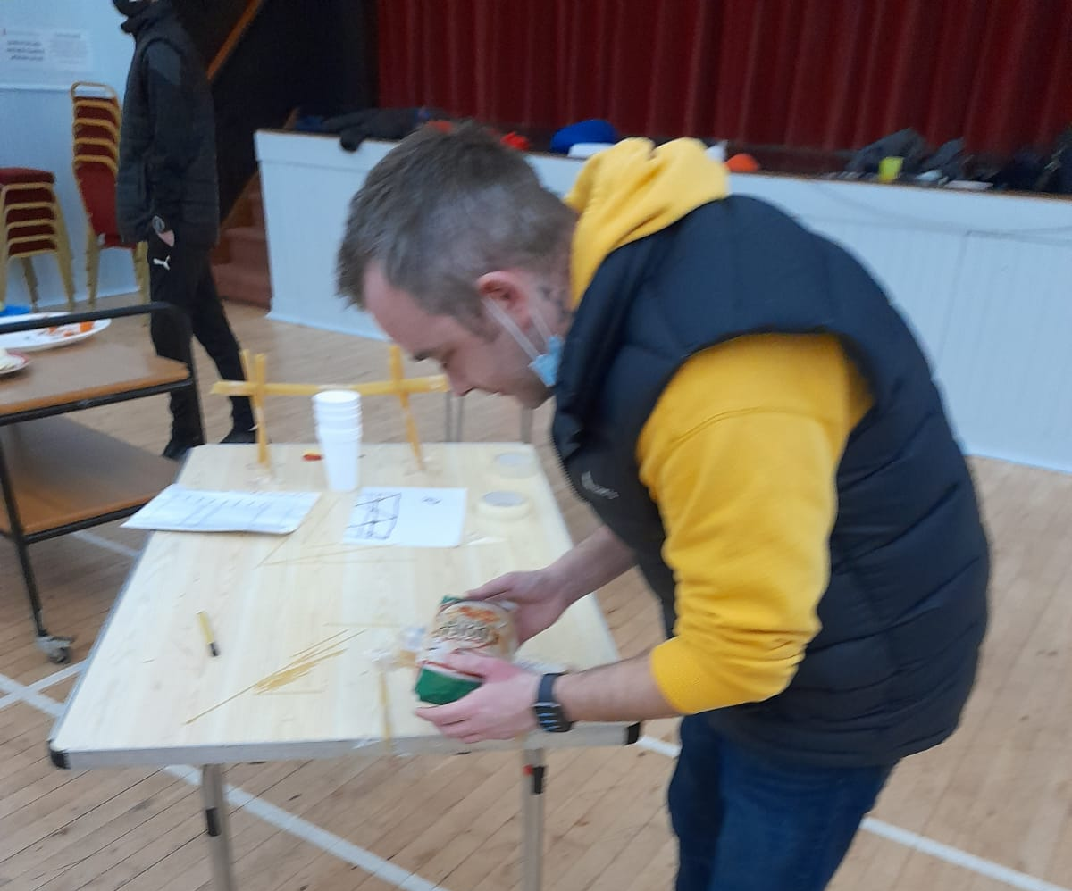
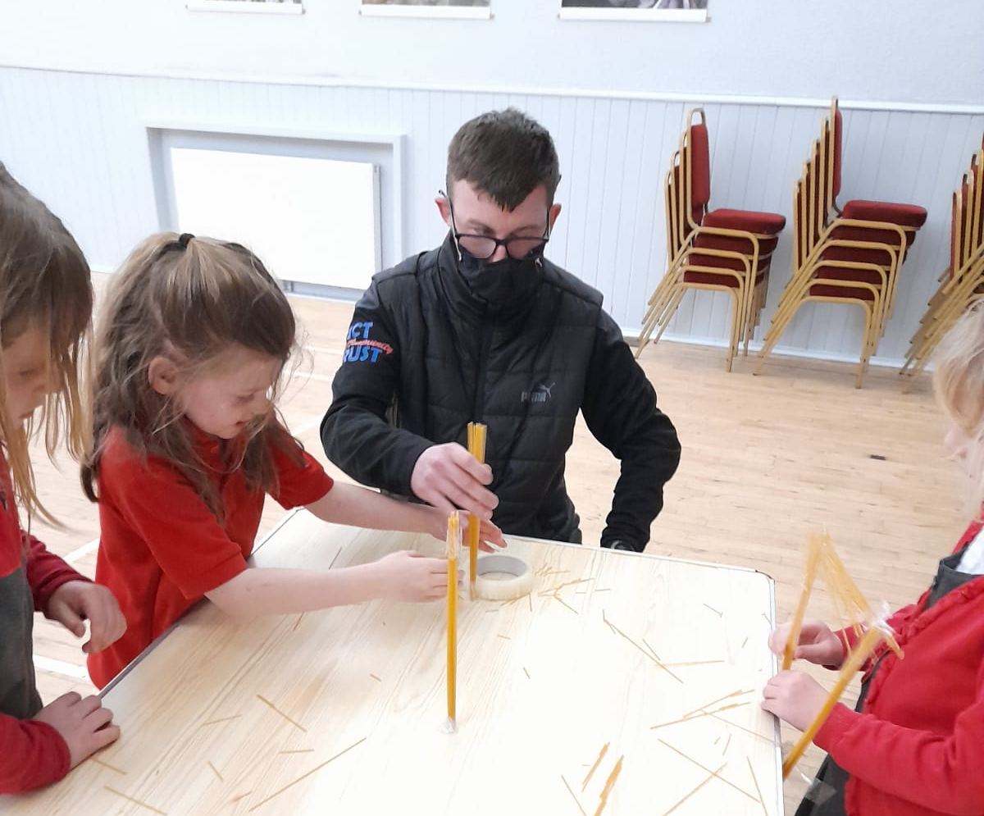
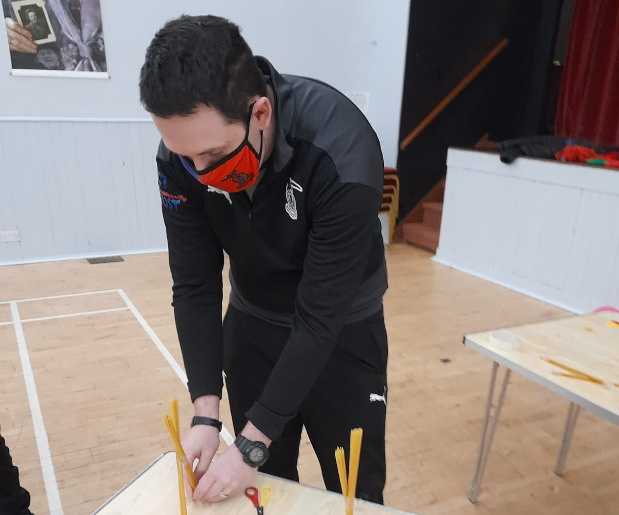

Slide 25
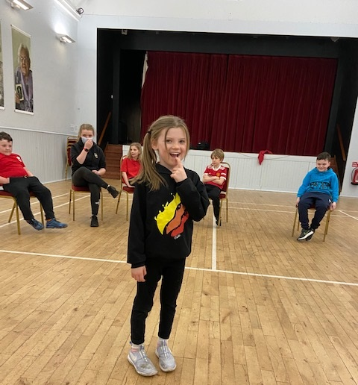
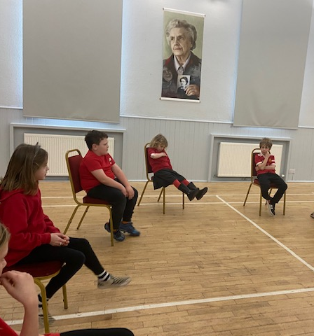

Slide 26
Cfine February ½ pallet.
Half Pallet of food delivered to Cromarty Youth Café in February 2022
Who we have helped / donated food packs to:
Families in Isolation with COVID
Young people who are on the verge of becoming Homeless
Vulnerable adults who are facing heat or eat
Every member of Cromarty Youth Café received a Well being Bag
Every member of Cromarty Rowing Club received a Well-being Bag with various items, such as deodorant, pasta, rice, tuna, passata sauce and other items donated from Cromarty Youth Café & CCRC.
Some items were used at snack time at Youth Café,
Spaghetti Hoops on Toast, Marconi, Hot Dogs, Pot noodles, Homemade Pizza with the Passata Sauce
Fruit offered to every young person at activities
Cereal given to YP as part of their snack at youth café
Fruit crumbles made
Tea Loafs
Food packs given to young people who are transitioning into independents living with special characteristic

Slide 27
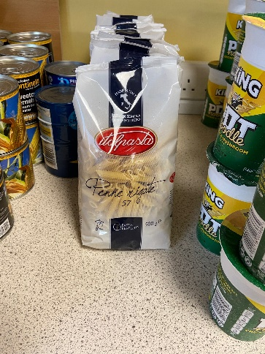
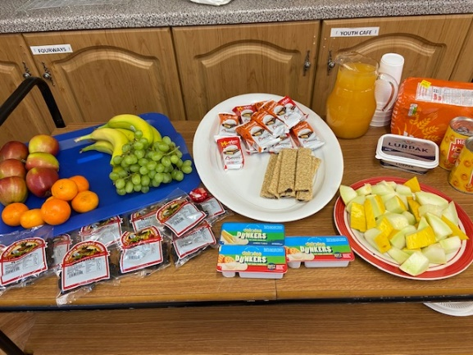
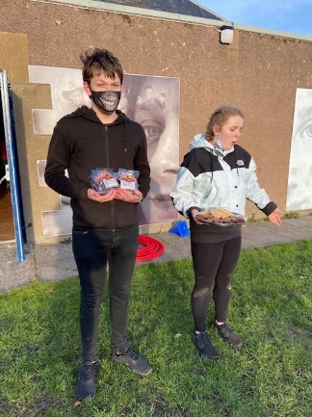
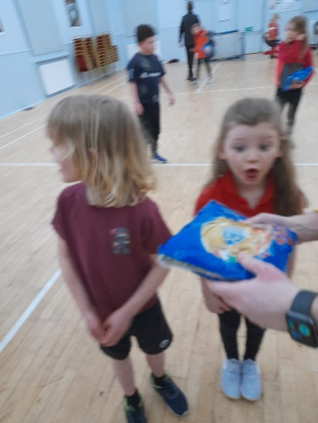
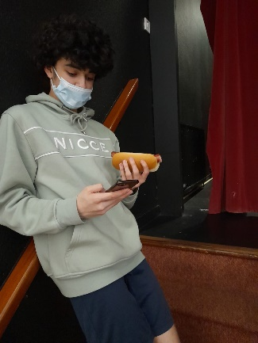
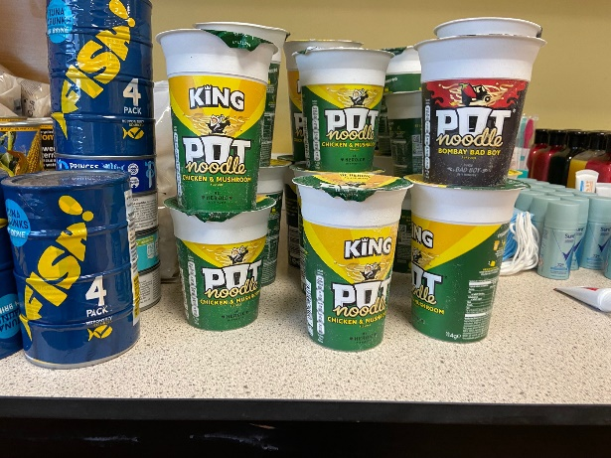
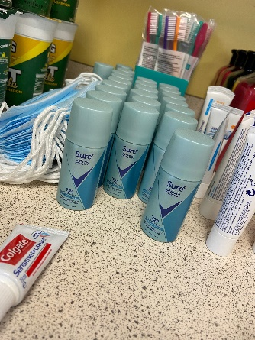
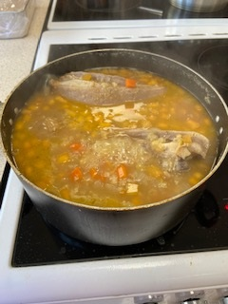
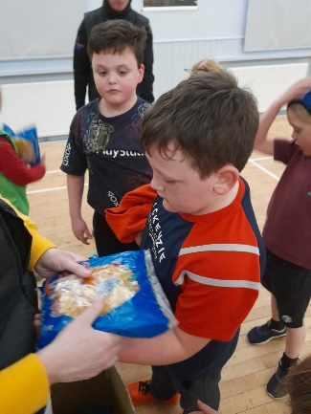

Slide 28
CCRC Health & Safety Meeting with Gill
Junior Reps of CCRC met with Gill Hubbard to discuss applying for funding to create health and safety videos for rowing, the young people thought the topics should be:
How to put on a lifejacket
How to use the VHF radio
Practicing 'man over board' and why keeping warm is important
Demonstrating What equipment is needed in the boat (e.g. bung, baler)
How to prepare a boat for a safe launch

Slide 29
Working Group / Committees Young People and ourselves are on
Black Isle Health and Well being Focus Group
Cromarty Community Rowing Club –
After a suicide Subgroup – Wanda
Cromarty Community Council X 2 Reps
Highland Youth Parliament X2 Reps
Northern Alliance
Cromarty Youth Café.

Slide 30
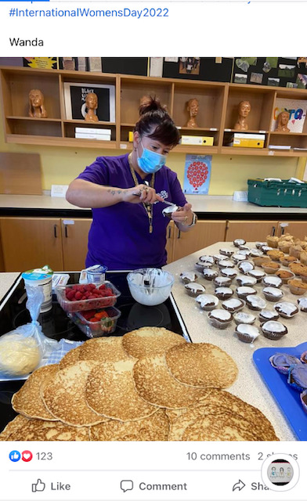
Happy International Women's Day to our very own Wonder Woman.! ☺

Slide 31
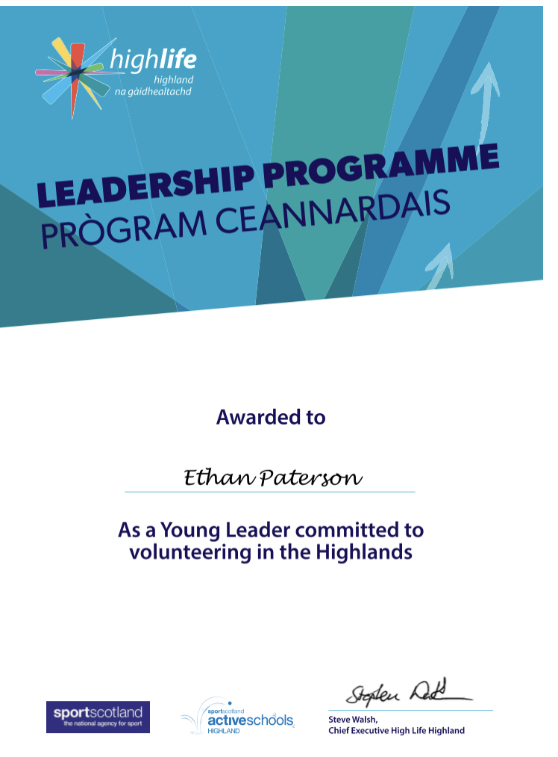
Saltire Award & HLH Leadership
Tracking and monitoring young people who are taking part in Saltire Awards or HLH Leadership.
Supporting YP to update diaries and timesheets.
Supporting YP to claim awards and certificates

Slide 32
I would like to say a Massive heartfelt thank you to Wanda for all her time and support towards the Youth Café
Thank you to Alan for all his support towards the Youth Café.

Slide 33
Thank You for taking your time in reading this report. As ever if you want to speak about any of the projects, please contact me. To keep up to date with what we are up please check our Facebook Page. Fraser Thomson Assistant Youth Worker Cromarty Youth Café

